Slide 1
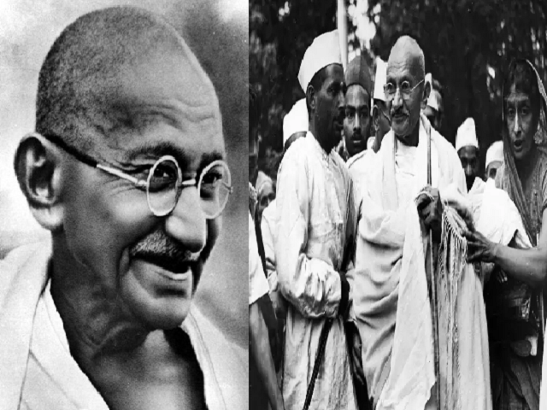
Gandhi and The Indian Freedom Movement"
Dr. Sahidujjaman Khan
Assistant Professor
Department of History
Tarakeswar Degree College

Slide 2
Introduction
Mohandas Karamchand Gandhi, also known as Mahatma Gandhi, played a pivotal role in India's freedom movement.
His philosophy of nonviolence (ahimsa) and civil disobedience inspired millions and became the guiding principles of the movement.

Slide 3
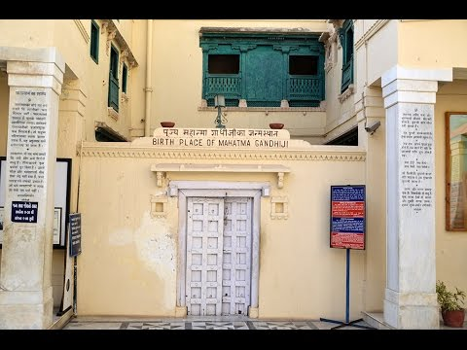
Early Life and Influences
Gandhi was born in 1869 in Porbandar, Gujarat, India.
His family and upbringing, influenced by Jainism, instilled in him a strong sense of morality and spirituality.

Slide 4
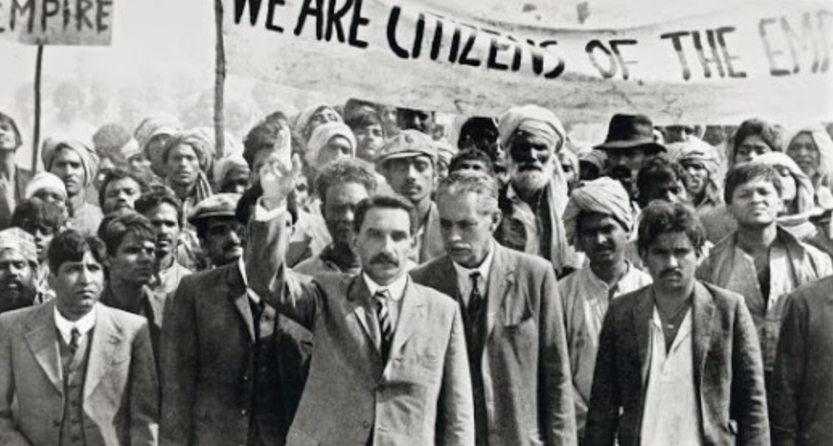
Experience in South Africa
Gandhi spent 20 years in South Africa, where he faced racial discrimination and fought for the rights of the Indian community.
These experiences shaped his political consciousness and provided the foundation for his future activism.

Slide 5
Return to India
Gandhi returned to India in 1915 and became actively involved in various social and political issues.
He aimed to unite the diverse Indian population and emphasized nonviolent resistance as a means to achieve freedom.

Slide 6
Champaran Satyagraha
The Champaran Satyagraha, launched in 1917, was one of Gandhi's first major movements in India.
He fought for the rights of indigo farmers and successfully challenged the oppressive British landlords.

Slide 7
Noncooperation Movement
The Noncooperation Movement was initiated by Gandhi in 1920 as a response to the Jallianwala Bagh massacre and other British injustices.
It involved mass civil disobedience and boycotts of British institutions, aiming to weaken British rule.

Slide 8
Salt March
The Salt March, also known as the Dandi March, took place in 1930 as a protest against the British salt tax.
Gandhi and thousands of followers marched to the coastal village of Dandi, making salt from seawater in defiance of the law.

Slide 9
Quit India Movement
The Quit India Movement was launched by Gandhi in 1942, demanding an end to British rule in India.
It sparked widespread protests and civil disobedience, leading to mass arrests and repression by the British authorities.

Slide 10
India's Independence and Gandhi's Legacy
India finally gained independence in 1947, but the struggle was not without sacrifices.
Gandhi's leadership and philosophy of nonviolence played a crucial role in achieving freedom.
He left a lasting legacy as a symbol of peaceful resistance, inspiring movements for freedom and human rights worldwide.

Slide 11
Conclusion
Summarize the key points discussed in the presentation, highlighting Gandhi's leadership and his impact on the Indian freedom movement.
Encourage further exploration of Gandhi's principles of nonviolence and civil disobedience.

